Slide 1

Chatbot for Information Retrieval from Website
Guided By:
Dr. Cerene Mariam Abraham, Assistant Professor
Muthoot Institute of Technology and Science
Presented By:
Eldho Ittan George, M.Tech,
Muthoot Institute of Technology and Science

Slide 2
Contents
Introduction
Problem Statement
Literature Review
Proposed Solution
Experiment Result
Limitations
Conclusion
References

Slide 3
Introduction
A website can be considered a wealth of information, providing everything a customer could possibly want to know.
Even though the information is readily available at the customer’s disposal, today’s busy customer doesn’t want to spend time searching for the answer.
Instead of wasting valuable and limited time searching, the customers should be able to interact with the website and get information more efficiently.

Slide 4
Problem Statement
Design and implement a chatbot system that can be integrated into any website for easier information retrieval by analyzing the text input.

Slide 5
Literature Survey
[1] Barbosa, A., & Godoy, A. (2021, November). Augmenting Customer Support with an NLP- based Receptionist. In Anais do XIII Simpósio Brasileiro de Tecnologia da Informação e da Linguagem Humana (pp. 133-142). SBC.
BERT based model is used for creating the chatbot.
Use a context evaluation model to differentiate between context and non-context queries.
The main purpose is to differentiate a question and forward it to the corresponding department in a company.
[2] Zhu, F., Lei, W., Wang, C., Zheng, J., Poria, S., & Chua, T. S. (2021). Retrieving and reading: A comprehensive survey on open-domain question answering. arXiv preprint arXiv:2101.00774.
Provide a short survey of existing QA systems.
Introduce details about the Retriever-Reader framework.

Slide 6
Literature Survey(Contd.)
[3] Cui, L., Huang, S., Wei, F., Tan, C., Duan, C., & Zhou, M. (2017, July). Superagent: A customer service chatbot for e-commerce websites. In Proceedings of ACL 2017, System Demonstrations (pp. 97-102).
Sentence similarity is used to find the best answer to the question.
DSSM models are used for finding similarities.
[4] Ranoliya, B. R., Raghuwanshi, N., & Singh, S. (2017, September). Chatbot for university-related FAQs. In 2017 International Conference on Advances in Computing, Communications and Informatics (ICACCI) (pp. 1525-1530). IEEE.
Use Artificial intelligence markup language for finding answers.
Question and answers will be predefined using AIML

Slide 7
Literature Survey(Contd.)
[5] Mondal, A., Dey, M., Das, D., Nagpal, S., & Garda, K. (2018, November). Chatbot: An automated conversation system for the educational domain. In 2018 International Joint Symposium on Artificial Intelligence and Natural Language Processing (iSAI-NLP) (pp. 1-5). IEEE.
Use features like no. of nouns, type of question, no. of verbs, Term Frequency.
Use methods like a random forest for finding suitable answers using the features.
[6] Bird, J. J. (2021). Improving Customer Service Chatbots with Attention-based Transfer Learning. arXiv preprint arXiv:2111.14621.
Shows effectiveness of transfer learning between different chatbots.

Slide 8
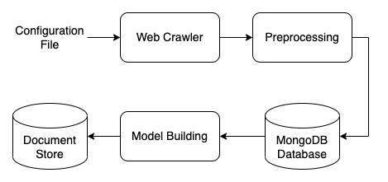
Proposed Solution
The proposed solution is divided into three modules:
Data Collection
Model
Model Deployment
Data Collection:
Given a URL the system will first collect all the textual data from the website.
System Architecture

Slide 9
Proposed Solution(Contd.)
The data will be collected using a web crawler and HTML parser.
The crawler will be constrained so that it won’t be running for infinity and it should not crawl to third party websites.
The data collected will be cleaned before giving it to the model.
Model:
The model handles the question answering part of the system.
There are mainly two components to the model:
Retriever
Reader

Slide 10
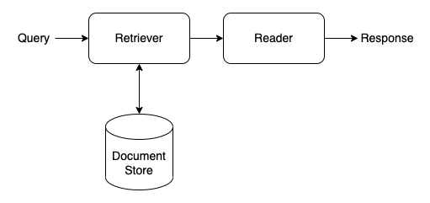
Proposed Solution(Contd.)
Retriever is used to extract relevant documents. It is based on DPR
The reader is used to extract the appropriate answer from the relevant documents. It is based on RoBERTa.
The document store(FAISS) is used to store the document embeddings.
The response of the model contains context, webpage URL and answer.
Context model architecture

Slide 11
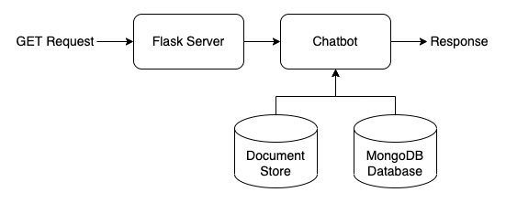
Proposed Solution(Contd.)
Model Deployment:
An API will be created to communicate with the model.
A Flask server will be developed to handle the API calls.
Model Inference

Slide 12
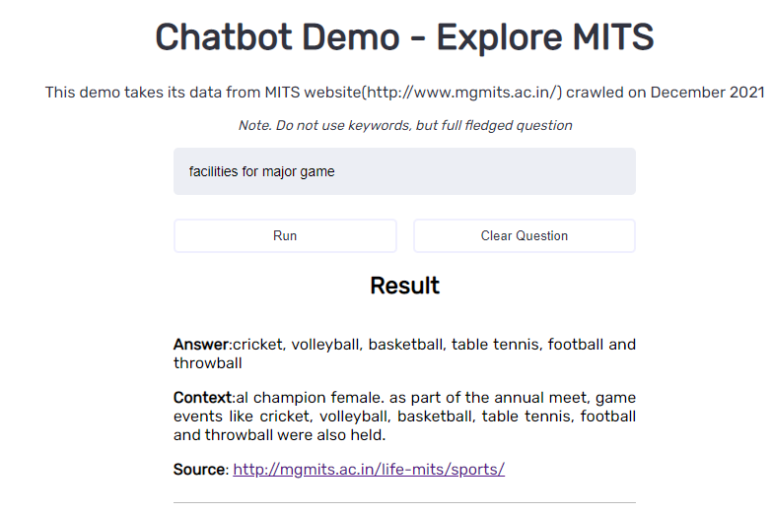
Experiment Result
We were able to create a chatbot that could answer questions based on the website's textual data.
What we found out was that if the answer existed in the text data that was given, the model was able to retrieve the answers correctly.
As this is an extractive model it was only able to extract a sentence that it found appropriate for the question.

Slide 13
Limitations
The current system is only limited to textual data on the website where more information sources like images, videos and audio exist. A multi-model system could be developed to handle this variety of data types.
The system is limited to the English language which could be improved by using multilingual language models.
Currently, we are using pre-trained models as such for creating the chatbot. In future works, models could be fine-tuned on website data.
The current model is an extractive QA model which could only extract a sentence. It could be replaced by a generative/abstractive QA model.

Slide 14
Conclusion
Our chatbot systems will provide more value to both web admins and users.
The users will be able to ask their queries directly to the chatbot and get a response.
The web admins will be able to create a good chatbot system without any manual work from them.

Slide 15
References
[1] Weston, J., Chopra, S., & Bordes, A. (2014). Memory networks. arXiv preprint arXiv:1410.3916. [2] Devlin, J., Chang, M. W., Lee, K., & Toutanova, K. (2018). Bert: Pre-training of deep bidirectional transformers for language understanding. arXiv preprint arXiv:1810.04805. [2] Liu, Y., Ott, M., Goyal, N., Du, J., Joshi, M., Chen, D., & Stoyanov, V. (2019). Roberta: A robustly optimized bert pretraining approach. arXiv preprint arXiv:1907.11692. [3] Pearce, K., Zhan, T., Komanduri, A., & Zhan, J. (2021). A Comparative Study of Transformer- Based Language Models on Extractive Question Answering. arXiv preprint arXiv:2110.03142.
[4] Barbosa, A., & Godoy, A. (2021, November). Augmenting Customer Support with an NLP- based Receptionist. In Anais do XIII Simpósio Brasileiro de Tecnologia da Informação e da Linguagem Humana (pp. 133-142). SBC.

Slide 16
References(Contd.)
[5] Cui, L., Huang, S., Wei, F., Tan, C., Duan, C., & Zhou, M. (2017, July). Superagent: A customer service chatbot for e-commerce websites. In Proceedings of ACL 2017, System Demonstrations (pp. 97-102).
[6] Ranoliya, B. R., Raghuwanshi, N., & Singh, S. (2017, September). Chatbot for university related FAQs. In 2017 International Conference on Advances in Computing, Communications and Informatics (ICACCI) (pp. 1525-1530). IEEE.
[7] Mondal, A., Dey, M., Das, D., Nagpal, S., & Garda, K. (2018, November). Chatbot: An automated conversation system for the educational domain. In 2018 International Joint Symposium on Artificial Intelligence and Natural Language Processing (iSAI-NLP) (pp. 1-5). IEEE.
[8] Sanh, V., Debut, L., Chaumond, J., & Wolf, T. (2019). DistilBERT, a distilled version of BERT: smaller, faster, cheaper and lighter. arXiv preprint arXiv:1910.01108.
[9] Karpukhin, V., Oğuz, B., Min, S., Lewis, P., Wu, L., Edunov, S., ... & Yih, W. T. (2020). Dense passage retrieval for open-domain question answering. arXiv preprint arXiv:2004.04906.

